Slide 1
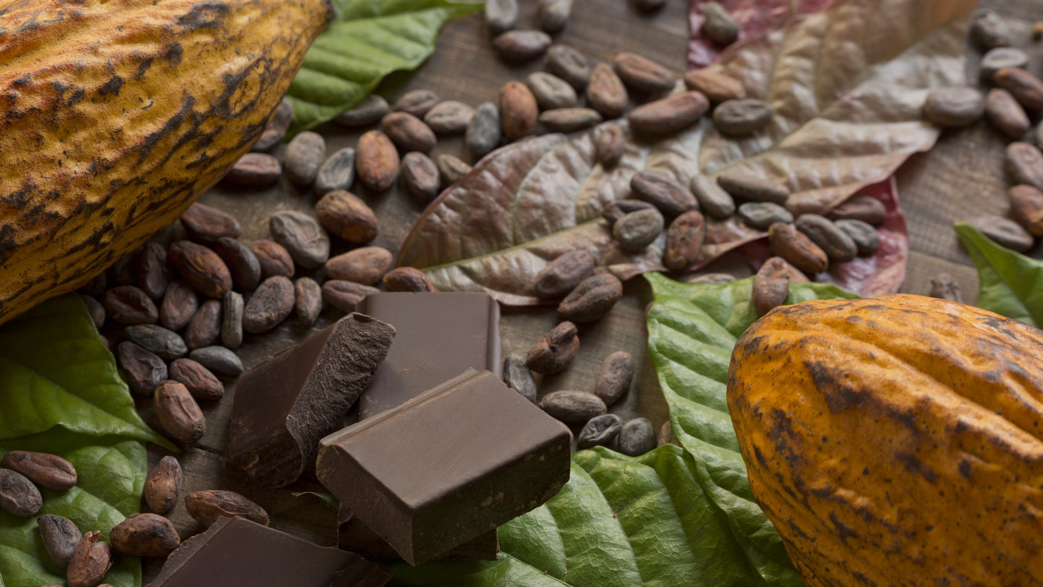
Predicting the Future Prices of Cocoa Beans on the ICE Contract Market
Clifford Cele

Slide 2
Introduction (1)
Supply & Demand of Cocoa Beans
Price of Cocoa Beans
Chocolate is made from the cocoa beans of cacao trees.
Cacao trees thrive in the rainforest and can only grow roughly 20 degrees north and south of the equator. ¹
Europe is the world’s largest hub for chocolate manufacturing, exports, and consumption.²
Hence demand/imports of cocoa beans is high in Europe.
2018 Market Share Imports: Netherlands (31%), Germany (10%), Belgium (8%), France (4%), etc.³
West Africa is the largest exporter of cocoa beans to Europe (74%).²
2019 Origin of European Imports: Ivory Coast (41%), Ghana (13%), Nigeria (9%), Cameroon (9%), etc.²
Ivory Coast and Ghana are the largest exporters of cocoa beans in the world (in 2018: 39% and 21% respectively).⁴
The mechanics of cocoa bean demand from Europe and supply in West African largely determine the price of cocoa bean products.
This price is negotiated with commodity futures.
A commodity future is a contract to buy or sell a specific quantity of a physical commodity at a specified price on a particular date in the future.⁵
Cocoa bean future contracts in Europe are traded on the London Intercontinental Exchange (ICE).

Slide 3
Introduction (2)
Data Source
Cocoa Bean Traded on: London ICE Futures
Units: GBP/Tonne
Date: 2000-2019 (daily)
Data Source: International Cocoa Organization (ICCO)⁶
Aggregated to monthly averages
Objective
Can future prices of cocoa beans on the ICE London contract market be forecasted between 2010 & 2019?

Slide 4
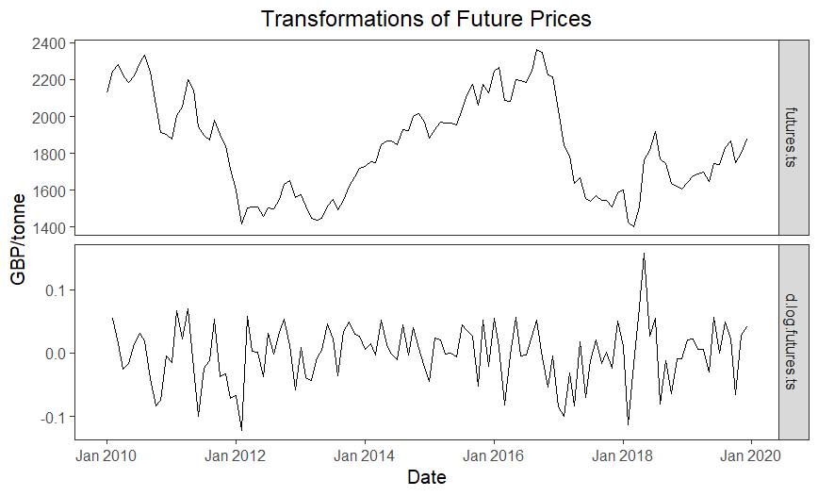
Data Exploration
Political unrest in the Ivory Coast between 2010-2011 and in 2017 led to the pullout of many international banks (2011) and to many foreign investors holding off their investments (2017). Both caused the future prices of cocoa beans to drop (red box).^{7,8}
Future Prices
Unstable variance → log transform
Changing Trend
Unit Root Test with Trend: Stationarity? ✘
Need to work in differences of log-time series
Log-Difference of Future Prices
Unit Root Test without Trend: Stationarity? ✓
Seasonal Plot (not shown): Seasonality? ✘
Volatility (red box)

Slide 5
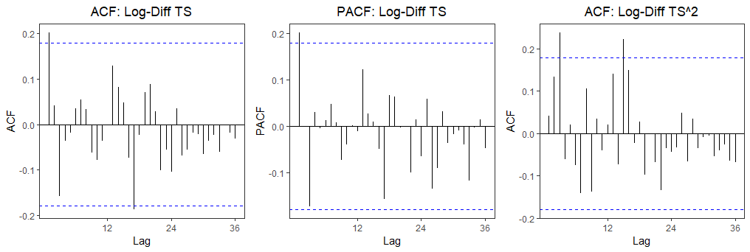
Model Specification
ACF (log-difference)
PACF (log-difference)
by chance from 95% CI
→ Random walk model
ACF (log-difference²)
High volatility
→ GARCH(1,1) model
→ AR(1) model
Significant lags = 1
Significant lags = 1, 17
Significant lags = 3, 15

Slide 6
Model Forecasting
Model | Goodness of Fit
 | In-Sample |  | Minimum Out-of-Sample⁺
 | AIC | SIC | RMSE | MAE
ARIMA(1,1,0) | -3.33 | -3.28 | S=60%, h=1, RMSE=0.0507 | S=60%, h=1, MAE=0.0379
ARIMA(0,1,0) | -3.31 | -3.28 | S=60%, h=1, RMSE=0.0514 | S=60%, h=1, MAE=0.0385
ARIMA(1,1,0) + GARCH(1,1)* | -3.35 | -3.24 | S=80%, h=12, RMSE=0.0342 | S=80%, h=12, MAE=0.0281
ARIMA(0,1,0) + GARCH(1,1)* | -3.34 | -3.27 | S=80%, h=12, RMSE=0.0339 | S=80%, h=12, MAE=0.0274
ARIMA(1,1,0) + GARCH(2,1) | -3.39 | -3.25 | S=80%, h=12, RMSE=0.0340 | S=80%, h=12, MAE=0.0278
ARIMA(0,1,0) + GARCH(2,1) | -3.37 | -3.28 | S=80%, h=12, RMSE=0.0339 | S=80%, h=12, MAE=0.0274
* Squared residuals from GARCH(1,1) model were correlated (LM ARCH test) and therefore not white noise (Ljung-Box test), warranting a higher-ordered GARCH model.
⁺S = Training set size, h = h-step ahead forecast with the test data (forecast for h = 1, 3, 6, 12 months).

Slide 7
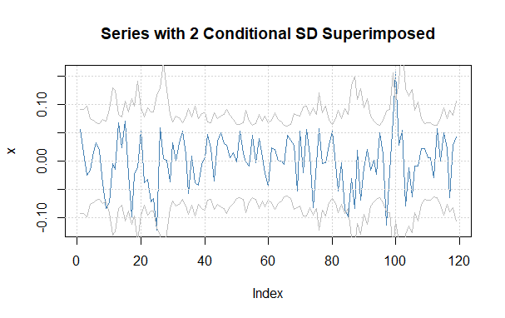
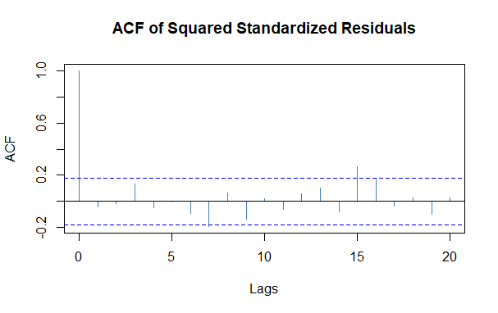
Model Validation
Model Selected: ARIMA(0,1,0) + GARCH(2,1)
Low in-sample & out-of-sample errors
The selected model can capture the conditional variance of the time series (as noted with gray lines)
The residuals from this model appear to be white noise.
There is one significant lag at 15, but this is likely due to chance from the 95% CI.

Slide 8
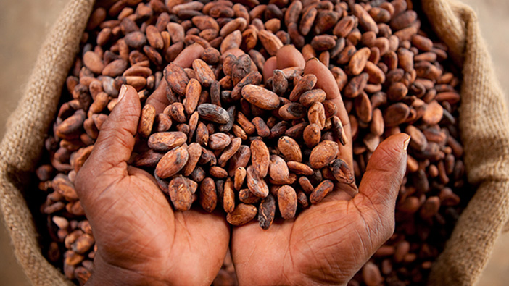
Discussion
The goal of this analysis was to predict the future prices of cocoa beans on the ICE London contract market be forecasted between 2010 & 2019.
An ARIMA(0,1,0) + GARCH(2,1) model was selected as the best option with an in-sample AIC = 3.37 & SIC = -3.28 and out-of-sample RMSE=0.0339 & MAE=0.0274.
Literature mentions that attempting to predict commodity futures is difficult/impossible. There are researchers using machine learning techniques to overcome this, e.g., long- and short-term time series networks (LSTNet).⁹
Another possibility is to conduct a multivariate analysis and investigate how import demands, deforestation, and climate change affect future prices.

Slide 9
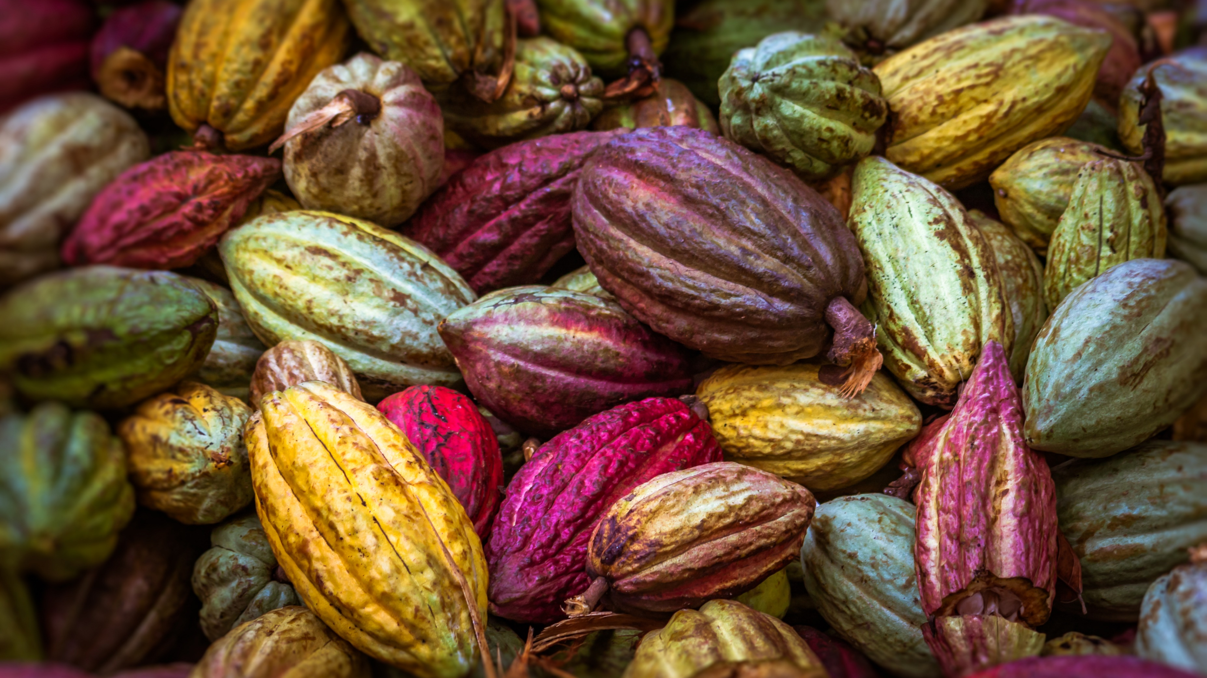
Bibliography
Scott, Michon. “Climate &amp; Chocolate.” NOAA Climate.gov, 16 Feb. 2016, https://www.climate.gov/news-features/climate-and/climate-chocolate. Accessed 5 November 2020.
“What Is the Demand for Cocoa on the European Market?” Centre for the Promotion of Imports (CBI) Ministry of Foreign Affairs (NL), https://www.cbi.eu/market-information/cocoa/trade-statistics. Accessed 30 October 2020.
“Where Did Côte D'Ivoire Export Cocoa Beans (1801 HS4) to in 2018?” The Atlas of Economic Complexity, @Harvardgrwthlab, https://atlas.cid.harvard.edu/explore?country=44&amp;product=804&amp;year=2018&amp;productClass=HS&amp;target=Product&amp;partner=undefined&amp;startYear=1995. Accessed 30 October 2020.
“Who Exported Cocoa Beans (1801 HS4) in 2018?” The Atlas of Economic Complexity, @Harvardgrwthlab, https://atlas.cid.harvard.edu/explore?country=undefined&amp;product=804&amp;year=2018&amp;productClass=HS&amp;target=Product&amp;partner=undefined&amp;startYear=1995. Accessed 30 October 2020.
“Basics of Futures Trading.” Commodity Futures Trading Commission (CFTC), https://www.cftc.gov/LearnAndProtect/AdvisoriesAndArticles/FuturesMarketBasics/index.htm. Accessed 30 October 2020.
“ICCO Statistics: Cocoa Daily Prices.” International Cocoa Organization, https://www.icco.org/statistics/. Accessed 30 October 2020.
Cocks, Tim. “Foreign Banks Suspend Ivory Coast Operations.” Reuters, Thomson Reuters, 17 Feb. 2011, https://www.reuters.com/article/us-ivorycoast-socgen/foreign-banks-suspend-ivory-coast-operations-idUSTRE71G099201102112.
https://fr.reuters.com/article/ozabs-uk-cocoa-ivorycoast-grinders-idAFKBN1
Hongbing Ouyang, Xiaolu Wei & Qiufeng Wu (2019) Agricultural commodity futures prices prediction via long- and short-term time series network, Journal of Applied Economics, 22:1, 468-483, DOI: 10.1080/15140326.2019.1668664

